Slide 1
Sudoku Project
Alp Doğan Fidan
090180320
MAT 335E

Slide 2
Why is Sudoku ?

Slide 3
What is Sudoku ?
In classic Sudoku, the objective is to fill a 9 × 9 grid with digits so that each column, each row, and each of the nine 3 × 3 subgrids that compose the grid (also called "boxes") contain all of the digits from 1 to 9.

Slide 4

Utilized Tools
JDBC Driver to connect MySQL database.
Java Swing for UI experiences.

Slide 5
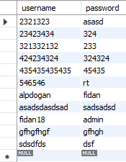
Database Table 1
user_table

Slide 6
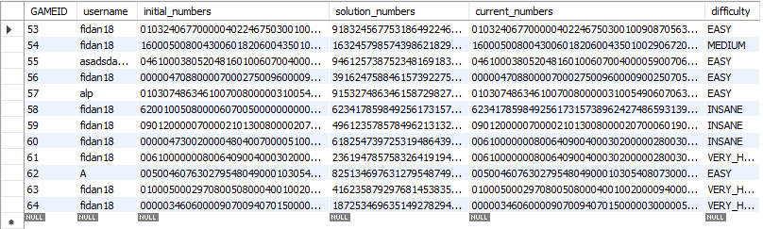
Database Table 2
sudoku_table

Slide 7
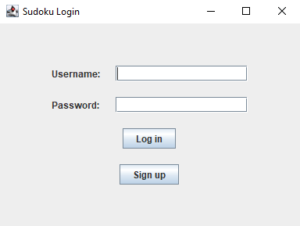
My Sudoku Project > Login
First, a new user have to sign up to play the game.

Slide 8
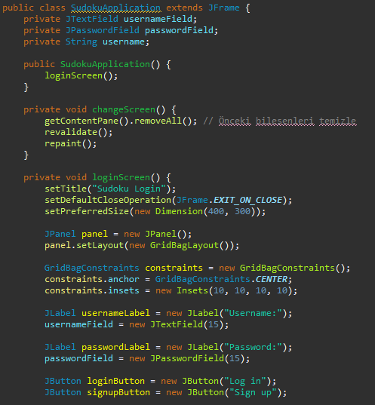
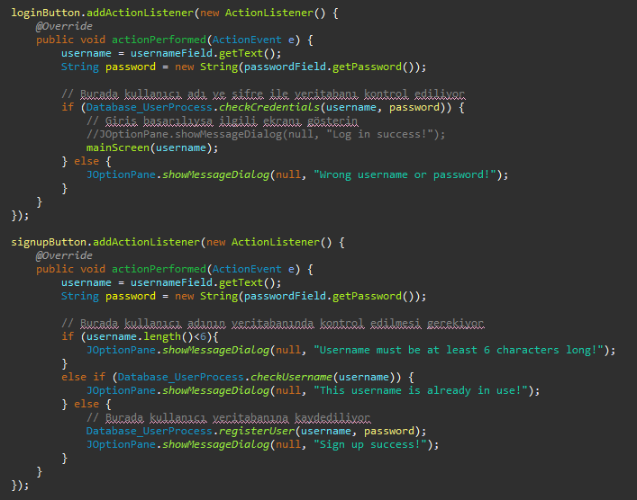

Slide 9
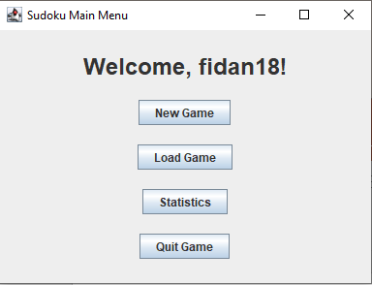
My Sudoku Project > Main Menu
After login, the main menu comes to screen.
The New Game button is clicked to create a new game.
The previously created games can be accessed by clicking the Load button.

Slide 10
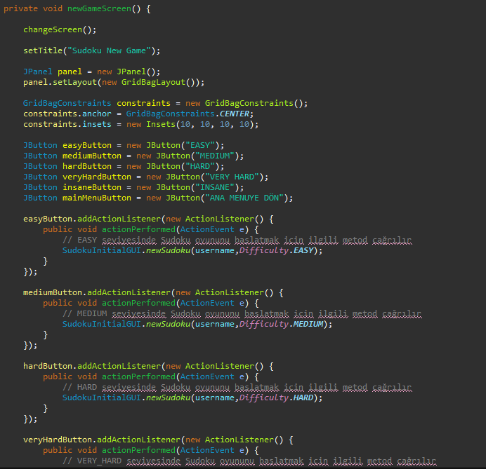
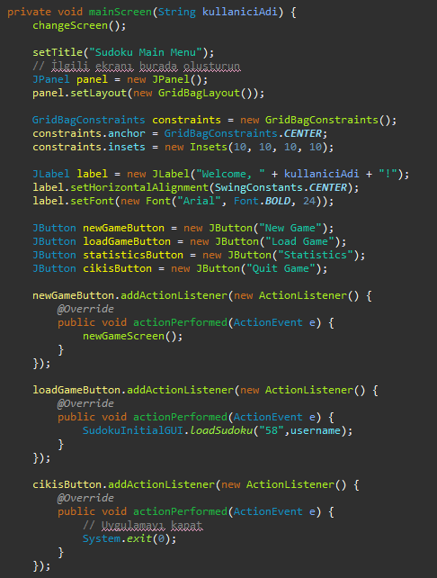

Slide 11
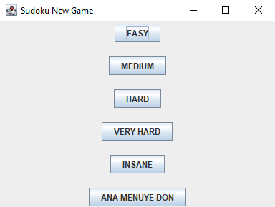
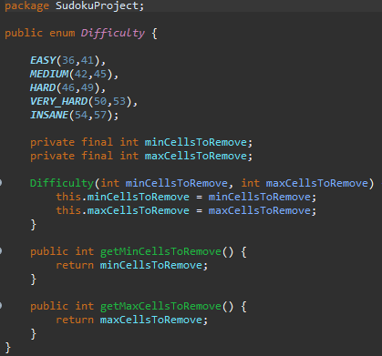
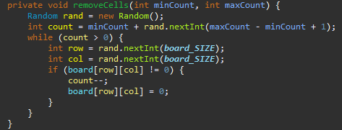
My Sudoku Project > New Game
When creating a new game, the difficulty of the game is selected first.

Slide 12
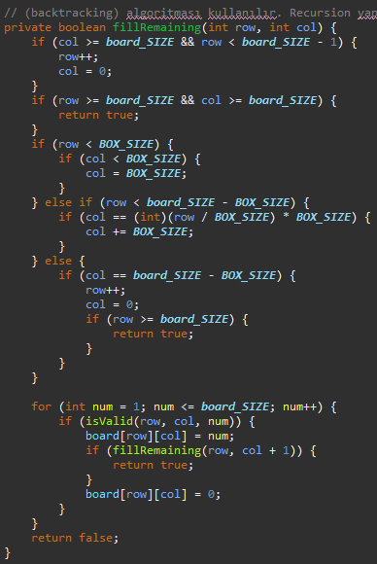
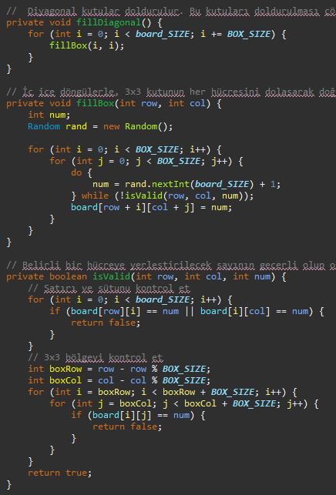
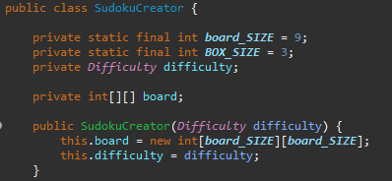
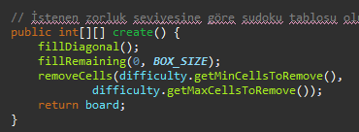
Sudoku Creator

Slide 13
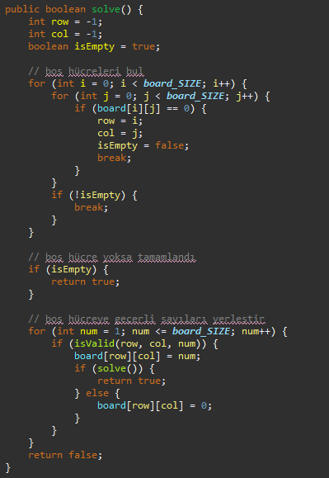
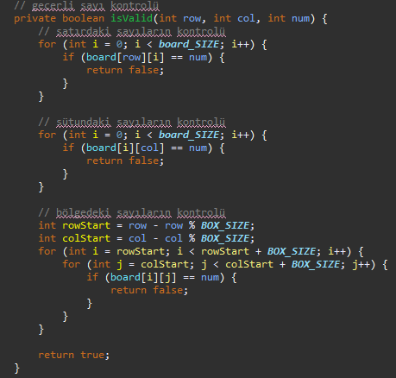
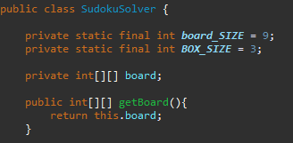
Sudoku Solver

Slide 14
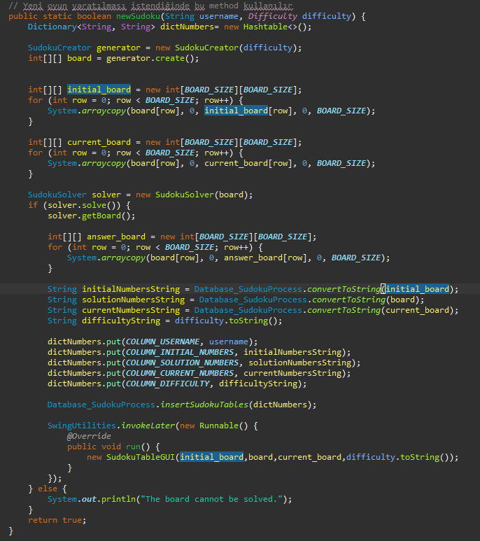
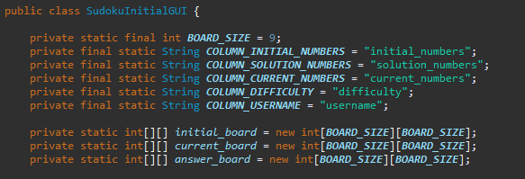
My Sudoku Project > New Game

Slide 15
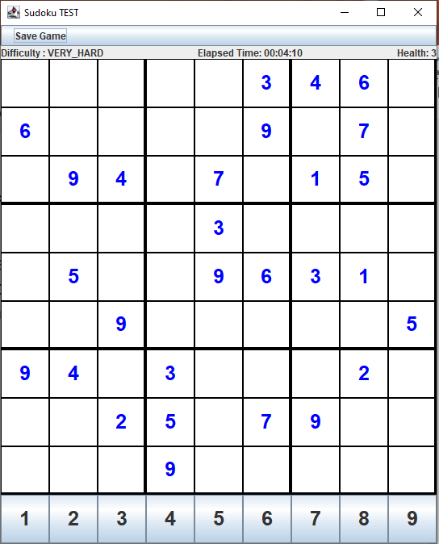
My Sudoku Project > Sudoku Game
For example, a new Sudoku game created with the VERY HARD option is as shown in the figure on the right.
Game starts with health = 3

Slide 16
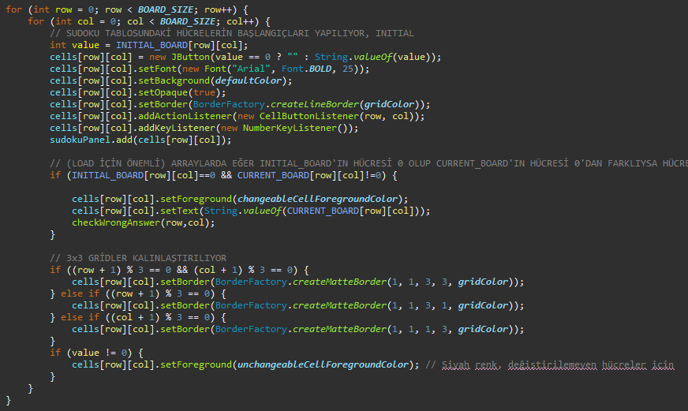
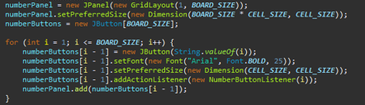
My Sudoku Project > Sudoku Game

Slide 17
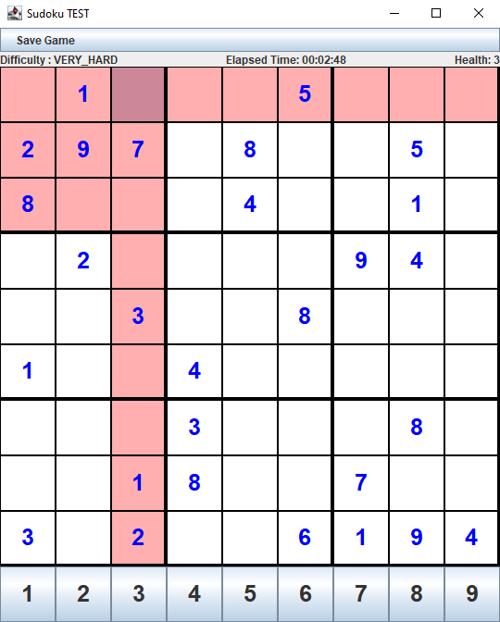
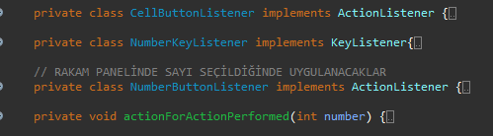
My Sudoku Project > Sudoku Game
When a cell is selected, the selected cell itself and the other relational cells are highlighted.

Slide 18
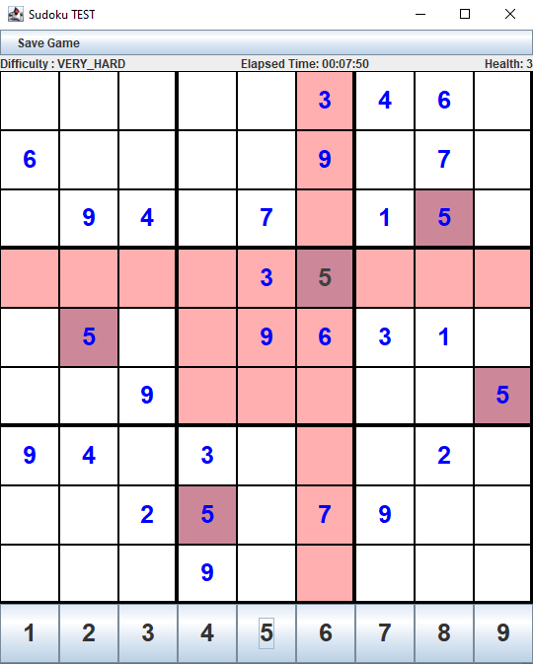
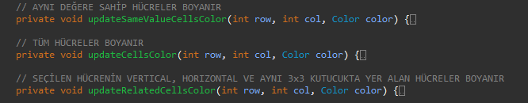
My Sudoku Project > Sudoku Game
When a cell is selected, pressing a number with the keyboard or clicking on one below updates the cell's value.
At the same time, other cells with the same value are also highlighted.

Slide 19
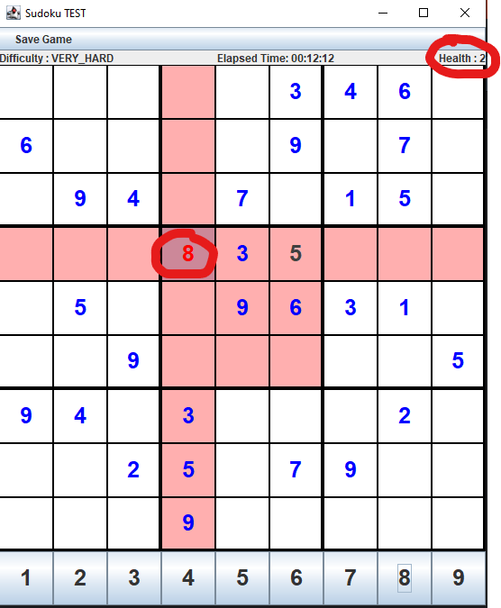
My Sudoku Project > Sudoku Game
When a wrong number is entered, the cell’s font is highlighted.
And also, the health value is decreased by 1.

Slide 20
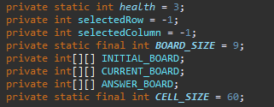
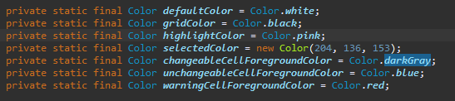
Additional
Sudoku variables.
Color palettes

Slide 21
Additional

Slide 22
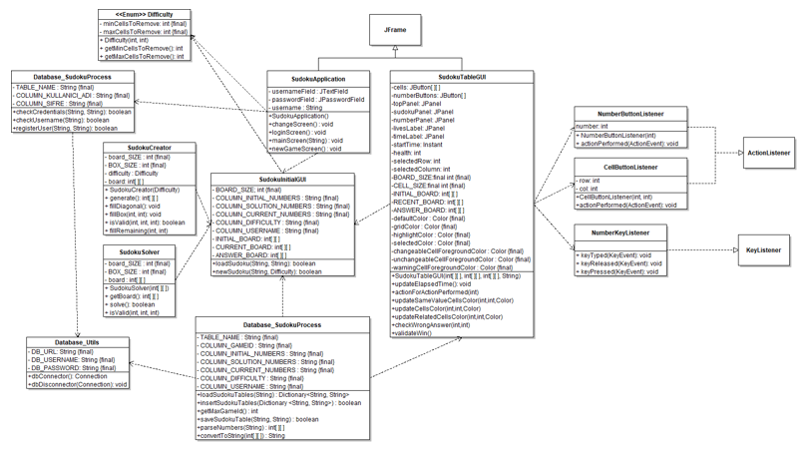
Challenges During Project
UI alignment.
Drawing UML.
Debugging Backend and Frontend.
Same variables at most classes
Wrong directories

